Slide 1
북한 코로나 19 모델링: Stochastic SEPIAR Modeling Approach
Jong-Hoon Kim, …
International Vaccine Institute
25 June 2022

Slide 2
Modeling process
Ask questions
Do the model-based inferences make sense?
Answer questions
Collect data
Estimate parameters
process & measurement
point & interval
Model
Adapted from Bolker (2007) Ecological Models and Data in R (p.27)

Slide 3
Ask Questions
연구목적
본 연구는 북한의 코로나19 감염병 발생 분석 및 과학적 대응을 위해 데이터에 근거한 모델링 분석과 향후 전망을 도출한다. 특히 북한 감염병 확진자 및 후유증 환자의 치료와 회복을 위한 방안을 제시하여 남북한 보건외교의 활성화와 국제사회의 인도주의적 대북 보건정책 연구에 기여한다
질문
‘모델링’ 방법을 이용하여 북한의 코로나 19 전파 자료를 더 잘 이해할 수 있을까?
‘모델링’을 통해 얻은 이해를 바탕으로 하여 더 나은 향후 전망을 할 수 있을까?

Slide 4
Collect data
연구목적
(2022-0811)_코로나19_노동신문_보도_현황표_전체_일일유열자.xlsx
(2022-0811)_코로나19_조선중앙TV_보도_현황표_시도별_일일유열자.xlsx
질문
‘모델링’ 방법을 이용하여 북한의 코로나 19 전파 자료를 더 잘 이해할 수 있을까?
그리고 더 나은 이해를 바탕으로 하여 더 나은 향후 전망을 할 수 있을까?

Slide 5
기술 분석
< 그림. Overall epidemic overlaid with intervention programs.>

Slide 6
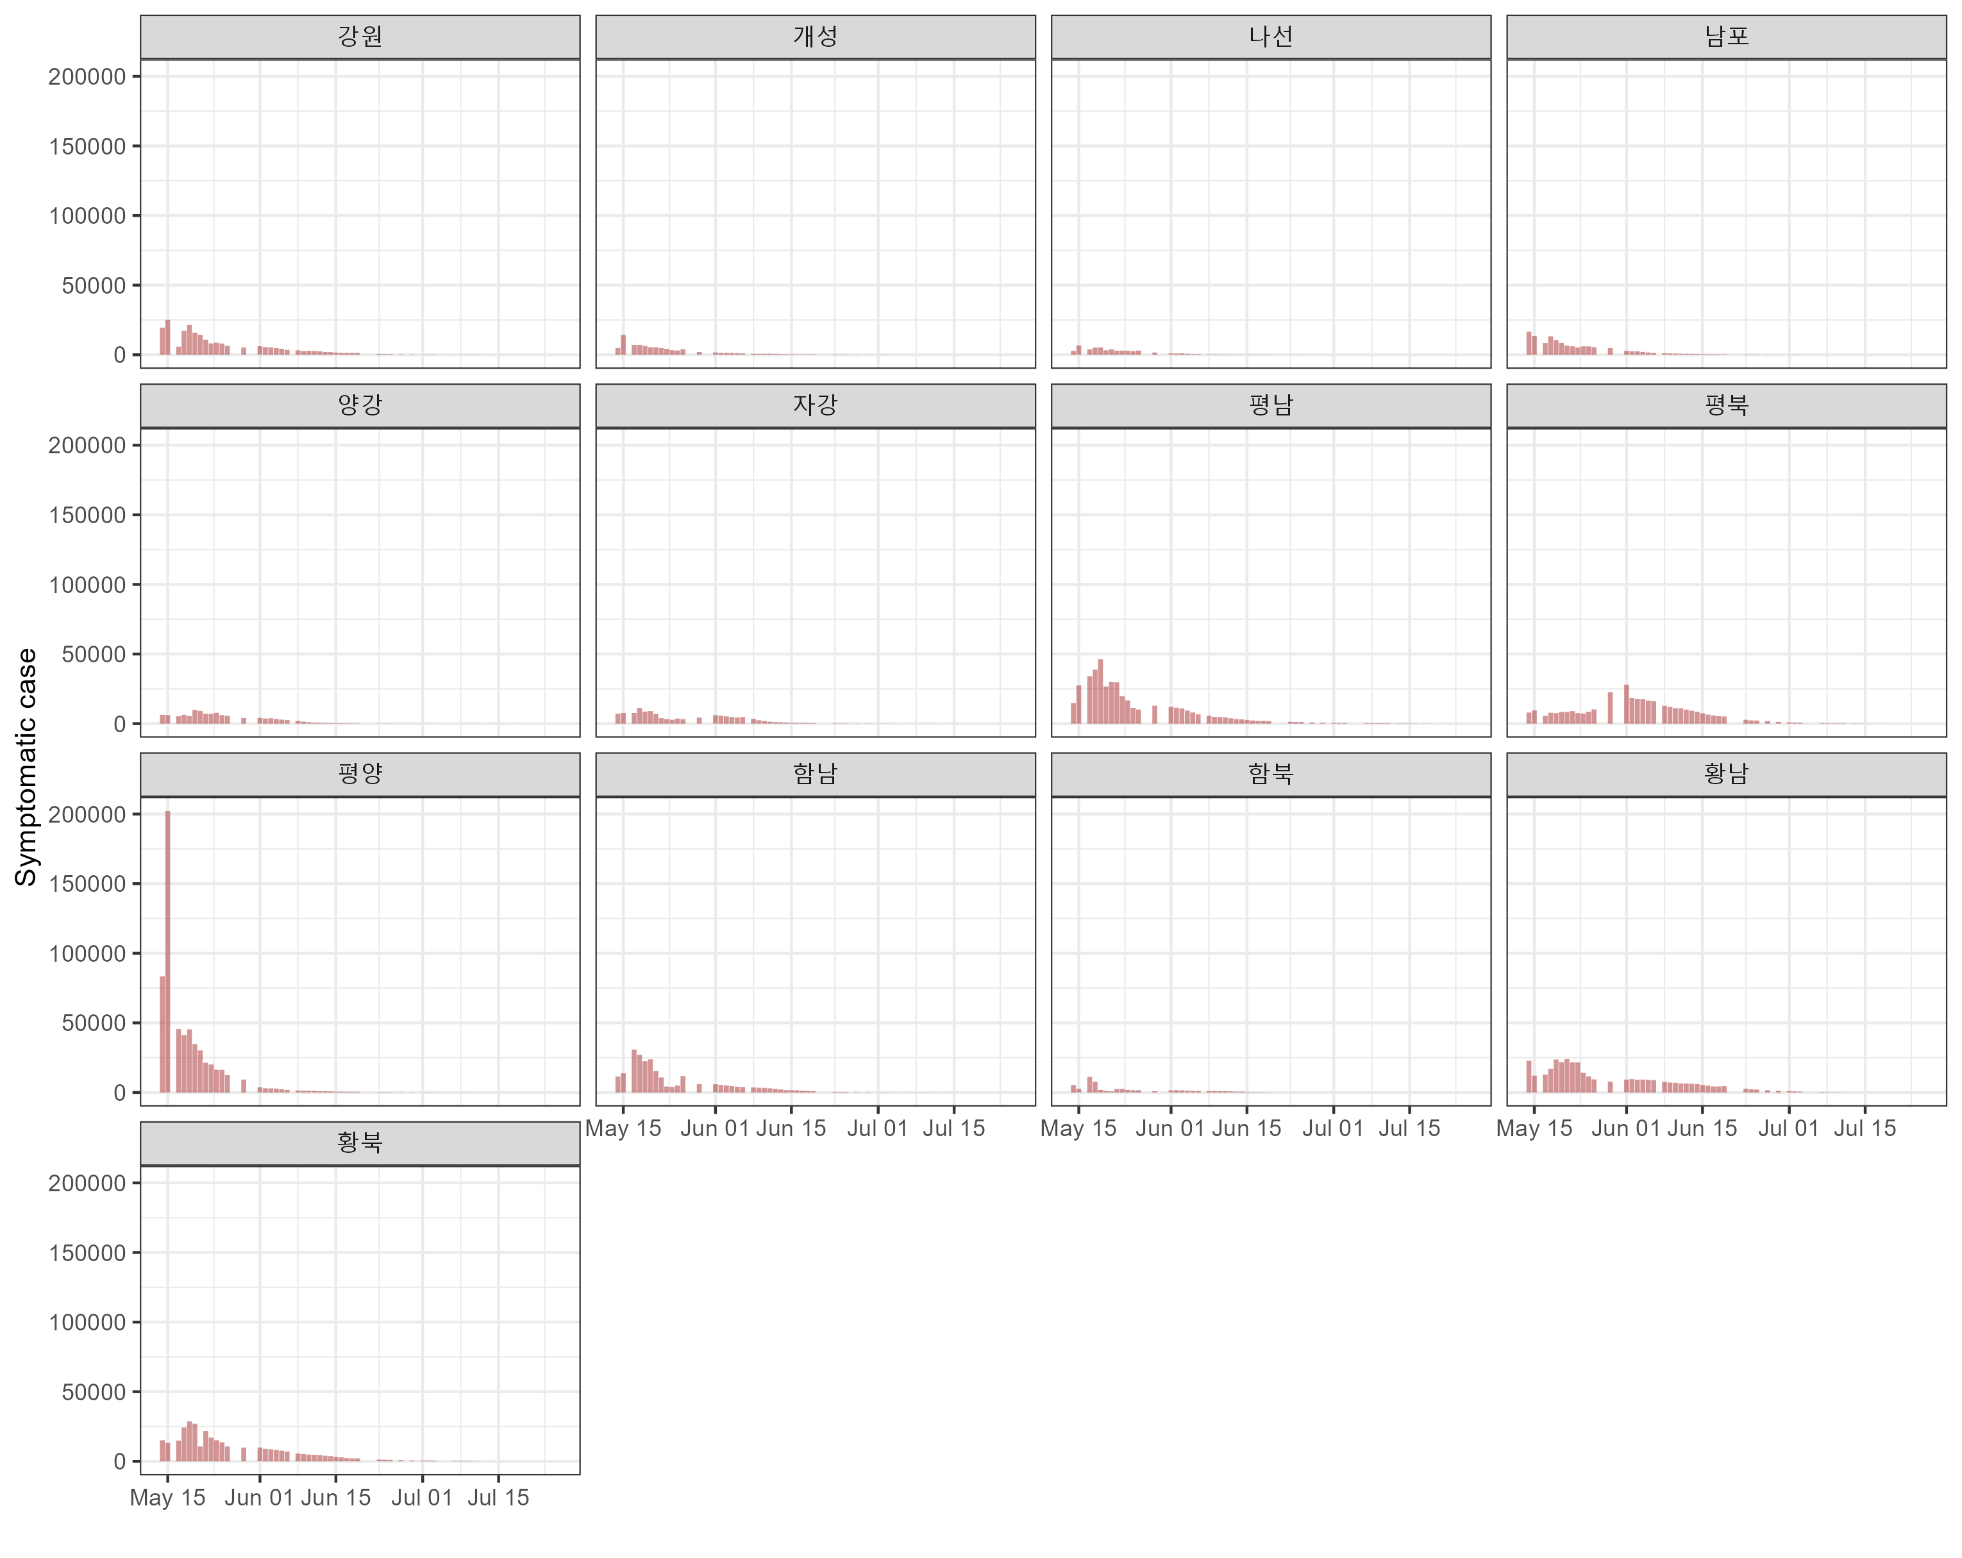
기술 분석

Slide 7
SEPIAR model
Data
I
S
E
P
R
A

Slide 8
Modeling: SEPIAR model

Slide 9
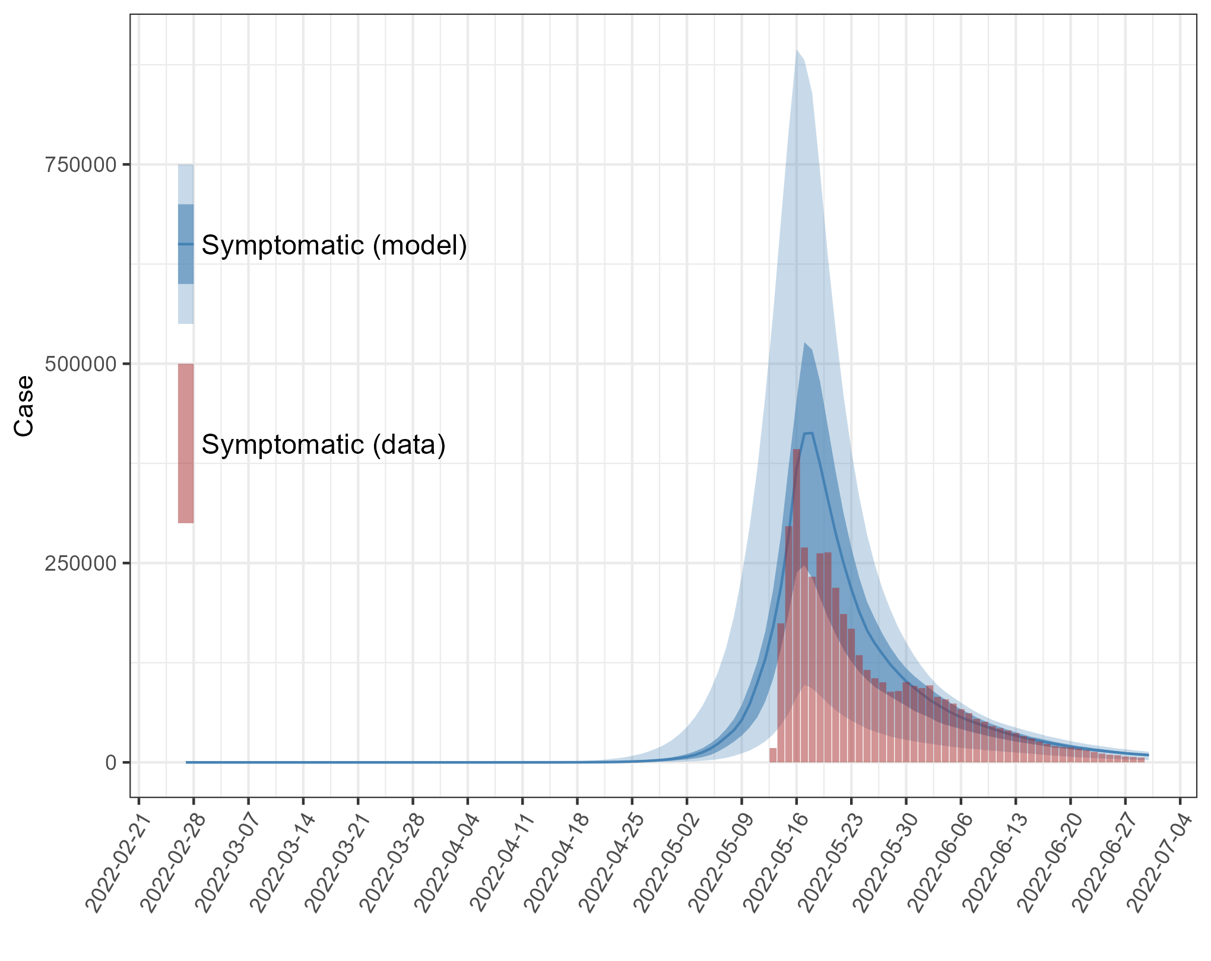
SEPIAR modeling: symptomatic cases
Computer codes are on GitHub: https://github.com/kimfinale/COVID-19_NorthKorea

Slide 10
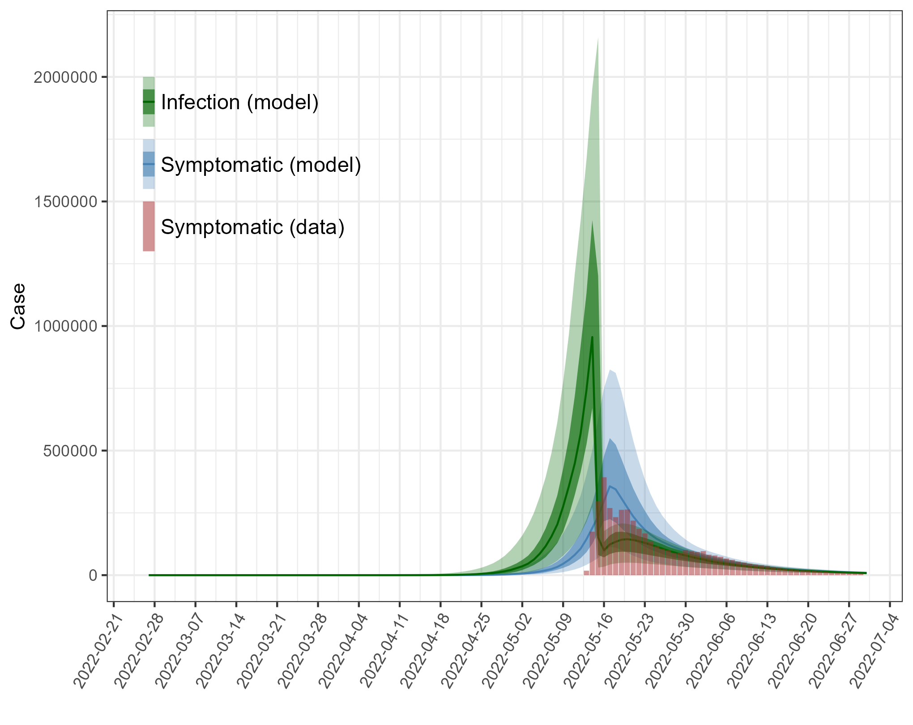
SEPIAR modeling: infections

Slide 11
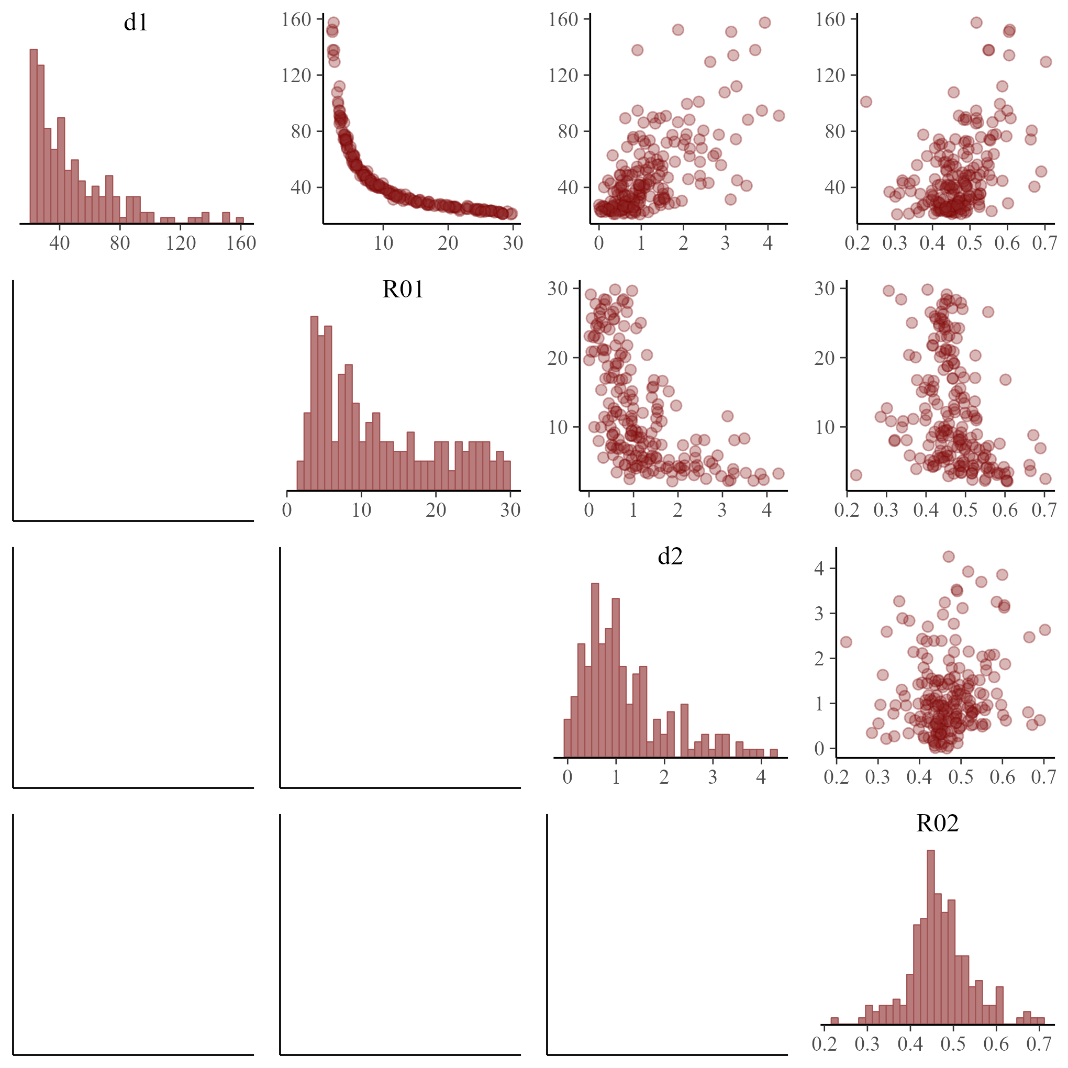
Parameter estimates

Slide 12
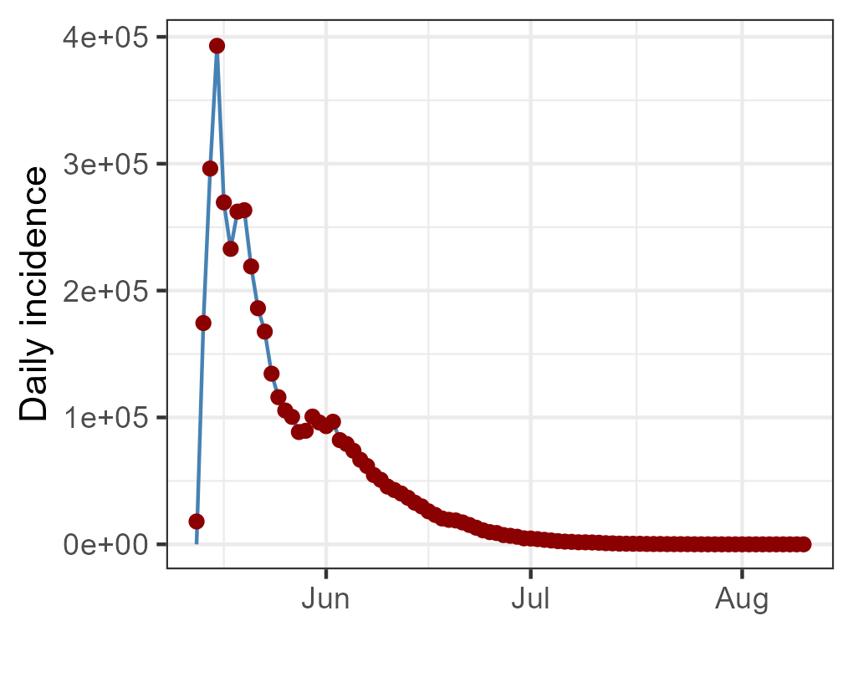
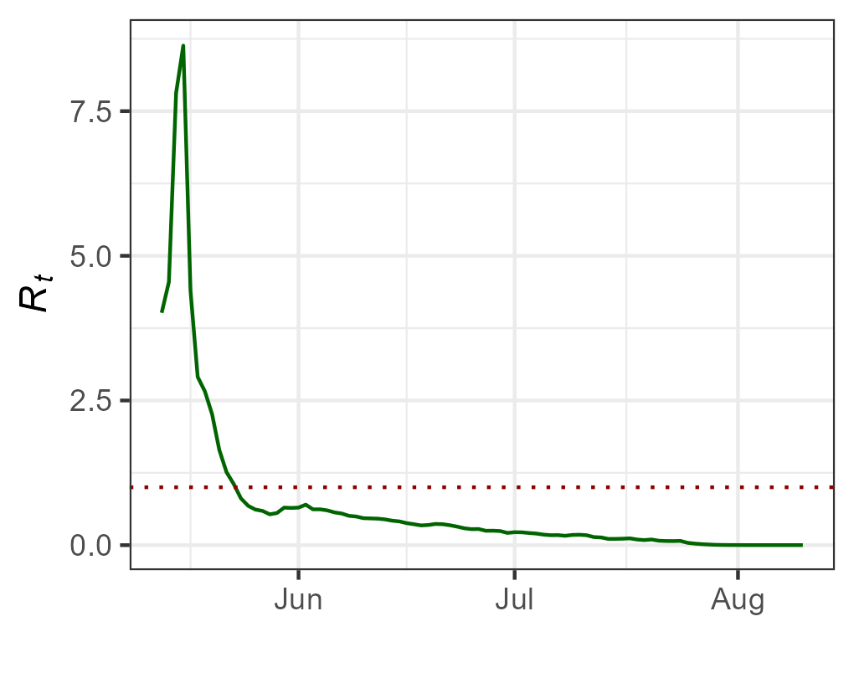
Rt based on the SEPIAR model + particle filtering
Input:
- Daily symptomatic cases (red dots)
- SEPIAR model
output:
- Model-predicted daily symptomatic cases (blue lines)
- Daily reproduction ratio (R_{t}) (green lines)

Slide 13
Topics
A model for the modeling process
Rapid spread of COVID-19 in Shincheonji Community (real-world problem)
Two-patch models of COVID-19 transmission (conceptual model)
Stochastic Susceptible-Exposed-Presymptomatic-Asymptomatic-Infectious-Recovered (SEPAIR) model (mathematical model)
Parameter estimation
Approximate Bayesian Computation Sequential Monte Carlo (ABC–SMC)
Reproduction number (R_{t}) of COVID-19 in Shincheonji and the rest
Hidden infections
Mixing between two patches
Interpretation
Notes:
.

Slide 14
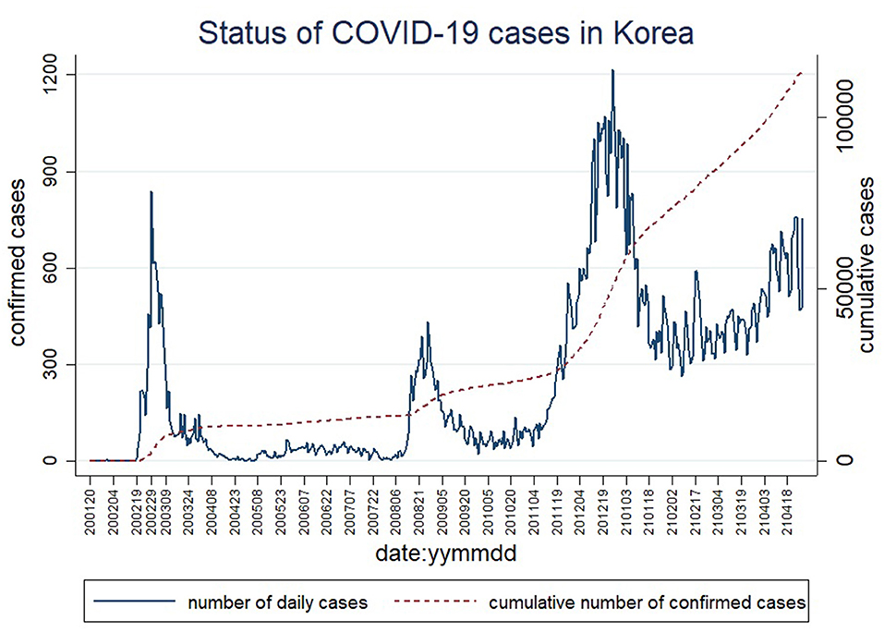
Daily confirmed COVID-19 cases in Korea
COVID-19 outbreak in Shincheonji
Park et al. (2021) Frontiers in Public Health

Slide 15
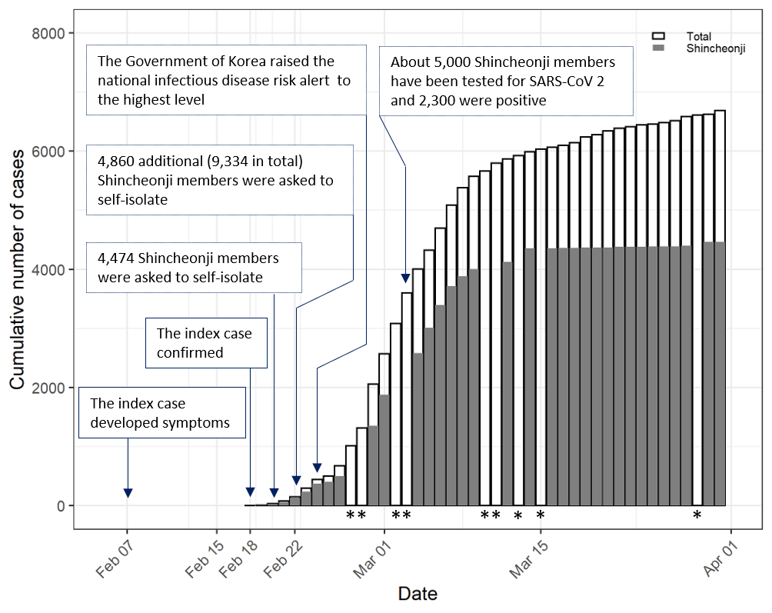
COVID-19 outbreak in Shincheonji Church of Jesus
Within two weeks, 3,081 connected cases were identified. The outbreak size doubled in less than every 2 days (14/log2(3081) ≈ 1.21)
Doubling time shorter than observed in the early stages of the COVID-19 outbreak in China (2.5 and 3.1 days in Hubei Province and Hunan Province, respectively)
Notes:
Doubling time = ln (2) / r, for r = ln (3018) / 14

Slide 16



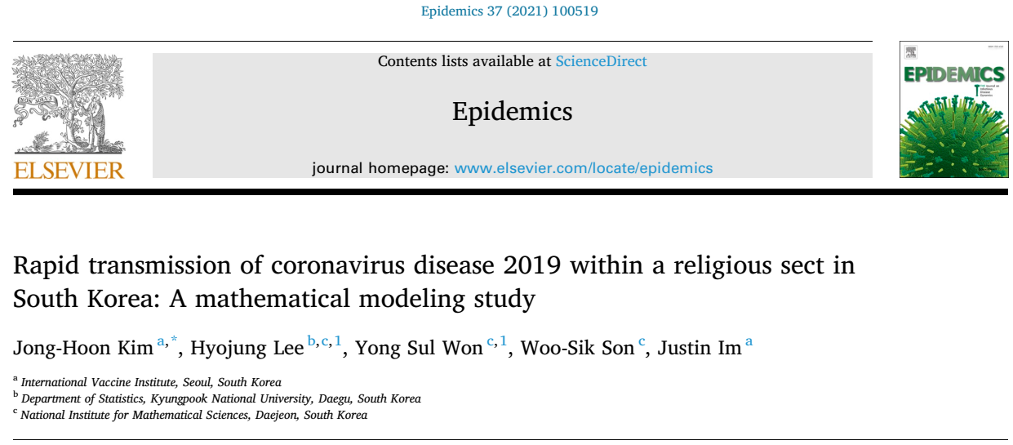
Acknowledgement
국가수리과학연구소: 손우식, 원용설
Notes:
.

Slide 17
Questions about the explosive spread of COVID-19 in Shincheonji
Basic reproduction number (R₀) for Shincheonji and non-Shincheonji people ?
Uncertainties around the epidemiology of the outbreak.
Hidden infections when the index case developed symptoms on Feb 7
The extent of cross-transmissions between Shincheonji and non-Shincheonji people

Slide 18

Shincheonji Church of Jesus
Worshipers used to sit close together on the floor and facial coverings, such as glasses and face masks, are forbidden.
Members were expected to attend services despite illness
The index case of the Daegu City attended worship together with some 1000 Shincheonji members.
https://www.bbc.com/news/av/world-asia-51851250

Slide 19
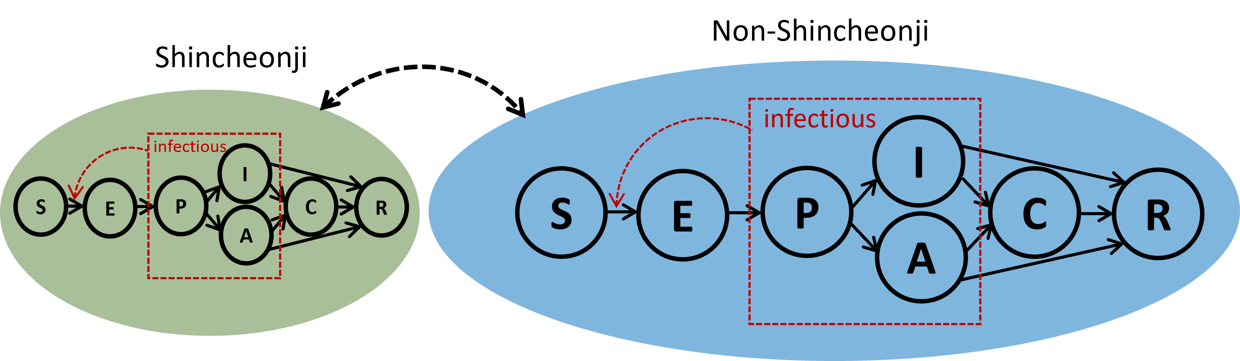
Two-patch SEPIAR model for the COVID-19 outbreak in Sincheonji
Includes pre-symptomatic (P), asymptomatic (A), and isolated (C) classes
Includes two patches between which cross-infection occurs
Smaller number of people in Shincheonji

Slide 20
Data
Daily reports from Korea Disease Control and Prevention Agency (KDCA)
Time series of patients confirmed with COVID-19 in Shincheonji community and the overall Daegu City over the period of 18 Feb – 31 Mar 2020
Cases confirmed with SARS-CoV 2 based on reverse transcription polymerase chain reaction (RT-PCR)
Natural history of infection
Incubation period, pre-symptomatic state, asymptomatic people
Number of Shincheonji people and the population size of Daegu

Slide 21
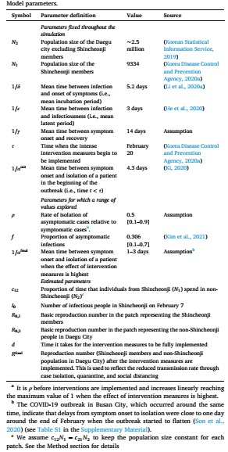
SEPAIR model parameters: fixed, varied, or estimated

Slide 22
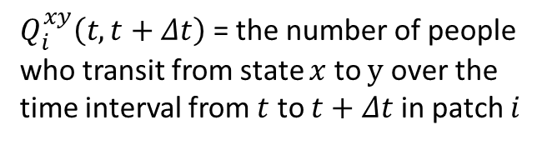
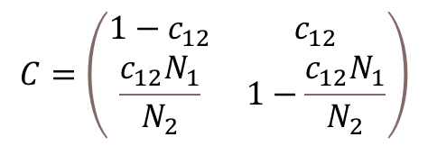
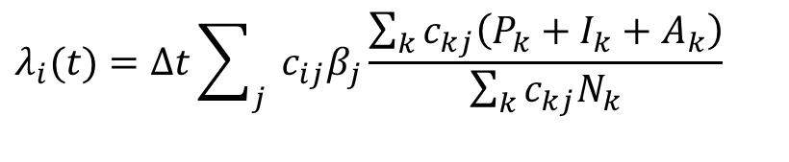
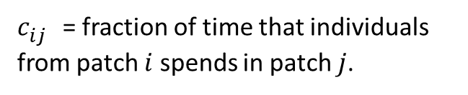
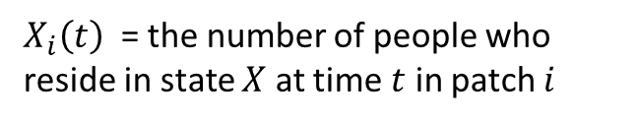
Mathematical model: tau-leaping method
$$Q_{i}^{SE}\left(t, t+Δt\right) \sim Binom\left(S\left(t\right), 1 −exp⁡\left[−λ_{i}(t)Δt\right]\right)$$
$X_{i}\left(t\right)$ = the number of people who reside in state $X$ at time $t$ in patch $i$
$$Q_{i}^{EP}\left(t, t+Δt\right) \sim Binom\left(E\left(t\right), 1 −exp⁡\left[−εΔt\right]\right)$$
$Q_{i}^{xy}\left(t,t+Δt\right)$= the number of people who transit from state $x$ to $y$ over the time interval from $t$ to $t+Δt$ in patch $i$
$$S_{i}\left(t+Δt\right)=S_{i}\left(t\right)−Q_{i}^{SE}\left(t, t+Δt\right)$$
$E_{i}\left(t+Δt\right)=E_{i}\left(t\right)+Q_{i}^{SE}\left(t, t+Δt\right)$- $Q_{i}^{EP}\left(t, t+Δt\right)$
$c_{ij}^{}$ = fraction of time that individuals from patch $i$ spends in patch $j$.
$$λ_{i}(t)=Δt\sum_{j}{{ c}_{ij}β_{j}\frac{\sum_{k}{c_{kj}\left(P_{k}+I_{k}+A_{k}\right)}}{\sum_{k}{c_{kj}N_{k}}}}$$
$$C=\left(\begin{matrix}1−c_{12} & c_{12} \\ \frac{c_{12}N_{1}}{N_{2}} & 1−\frac{c_{12}N_{1}}{N_{2}}\end{matrix}\right)$$

Slide 23
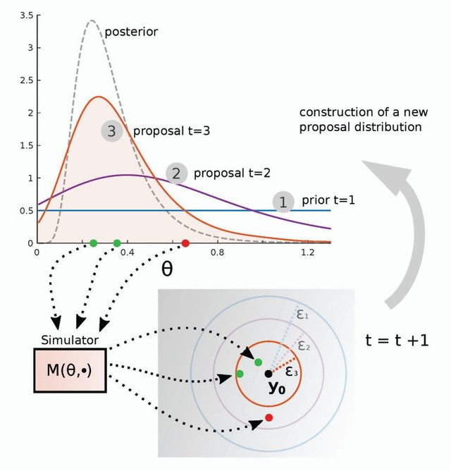
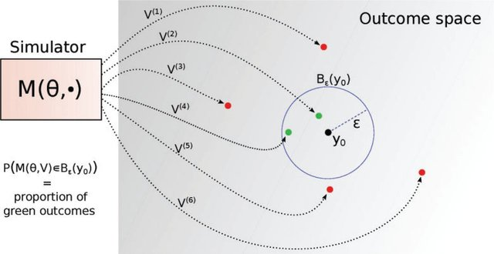
Parameter estimation: ABC SMC
Lintusaari (2016) Syst. Biol

Slide 24
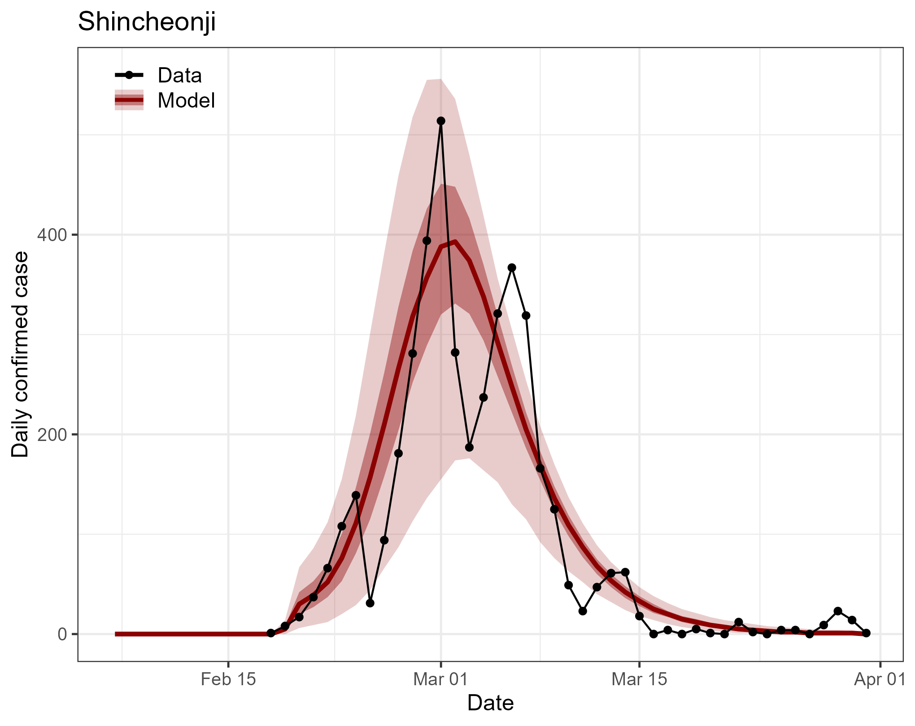
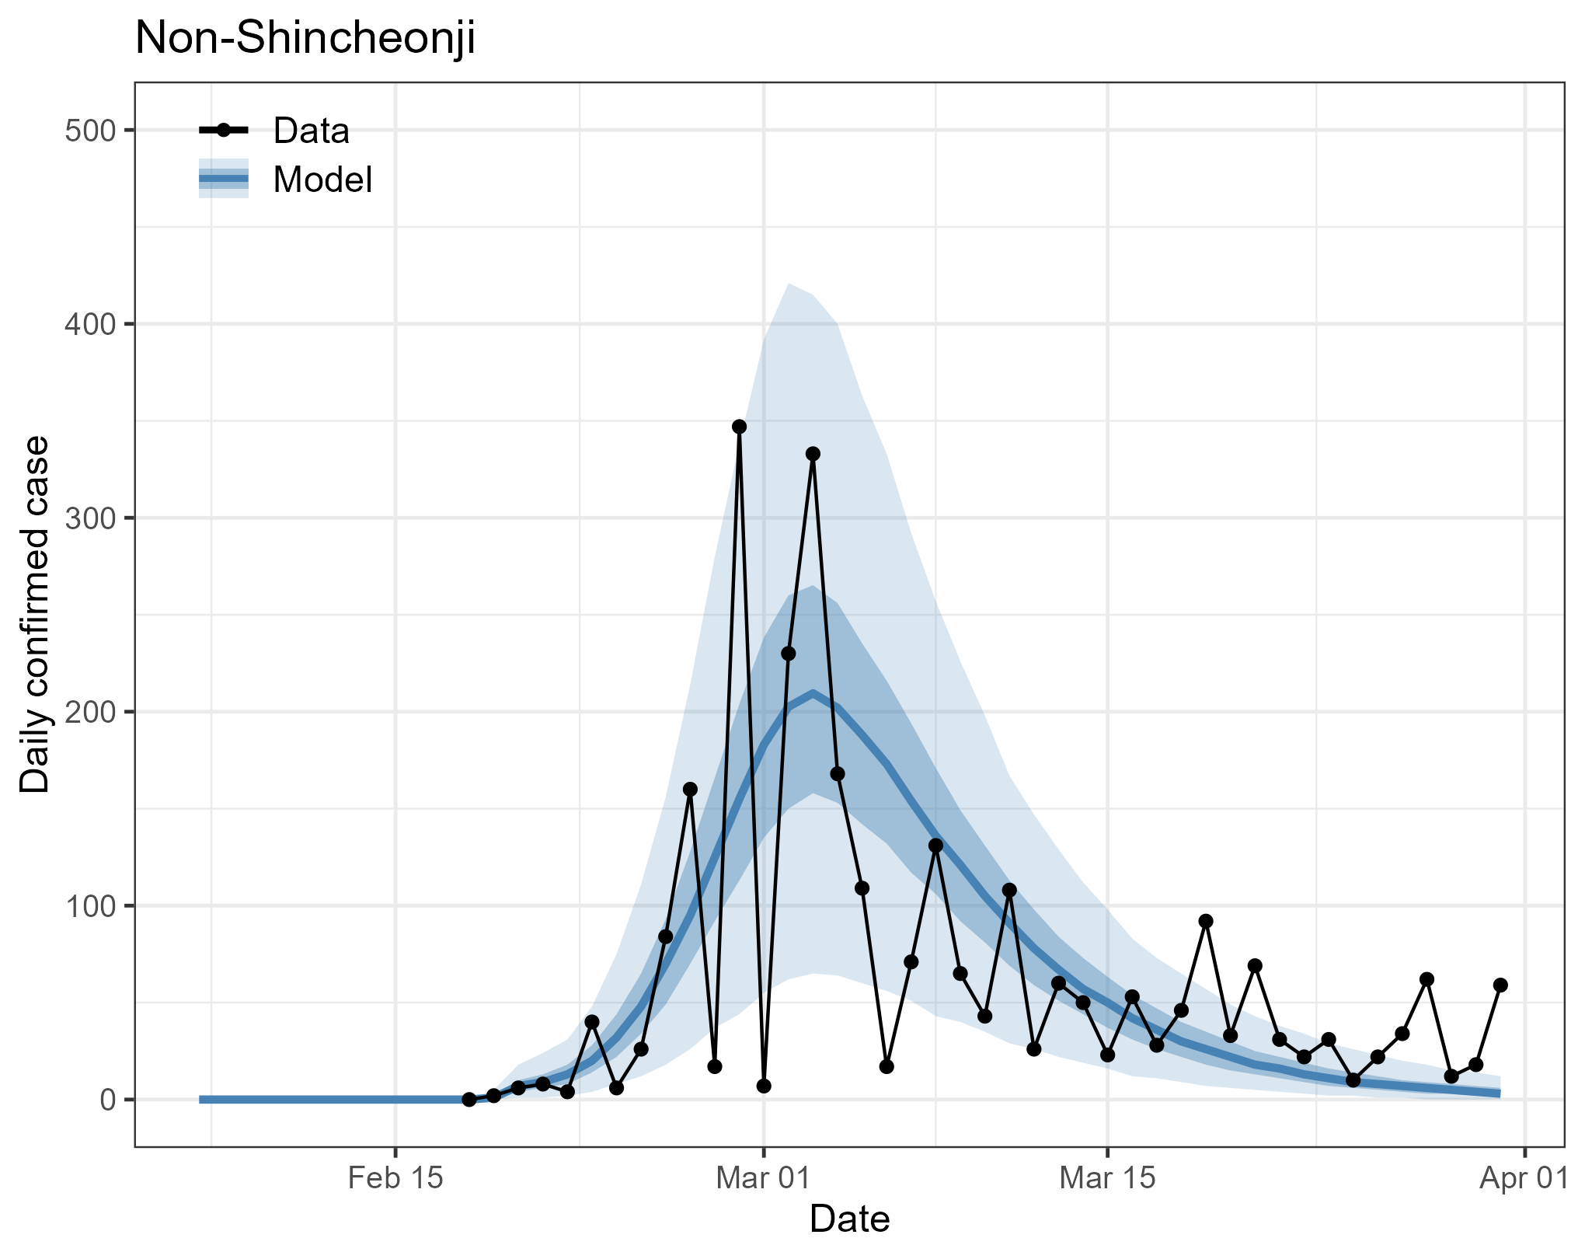
Model and data comparison: Daily confirmed cases
darker shade: 50%
lighter shade: 95%
line: median
Kim et al. Epidemics 37 (2021) 100519

Slide 25
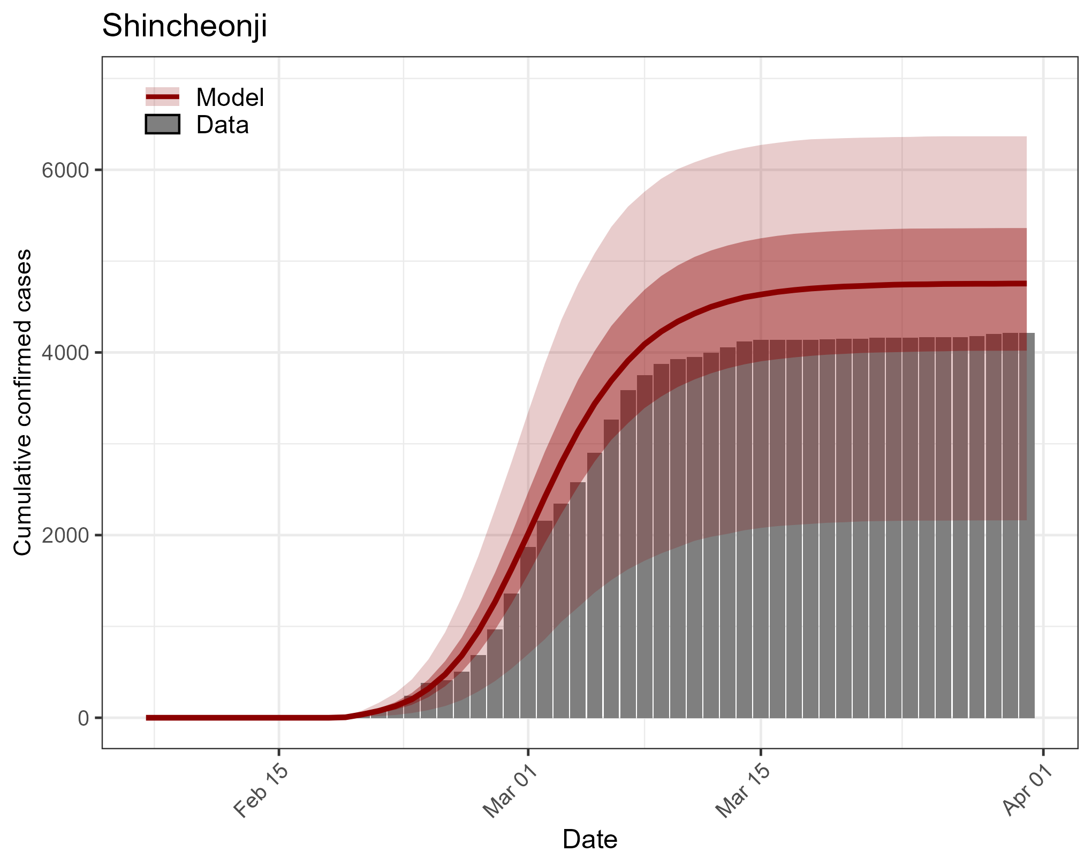
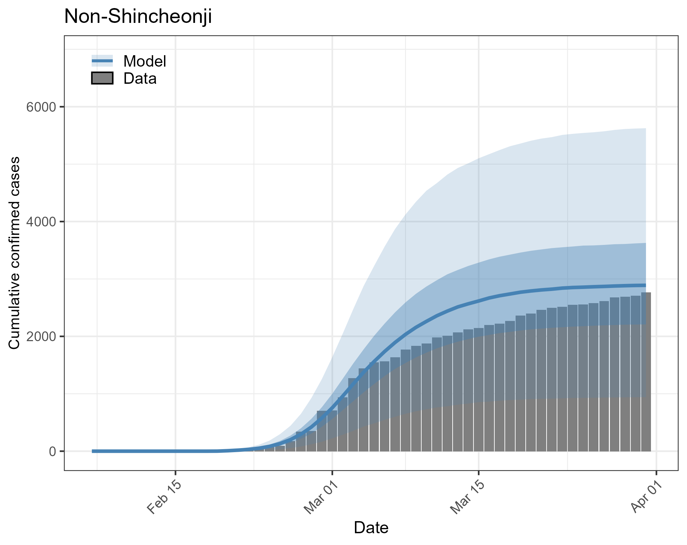
Model and data comparison: Cumulative confirmed cases
darker shade: 50%
lighter shade: 95%
line: median
Kim et al. Epidemics 37 (2021) 100519

Slide 26
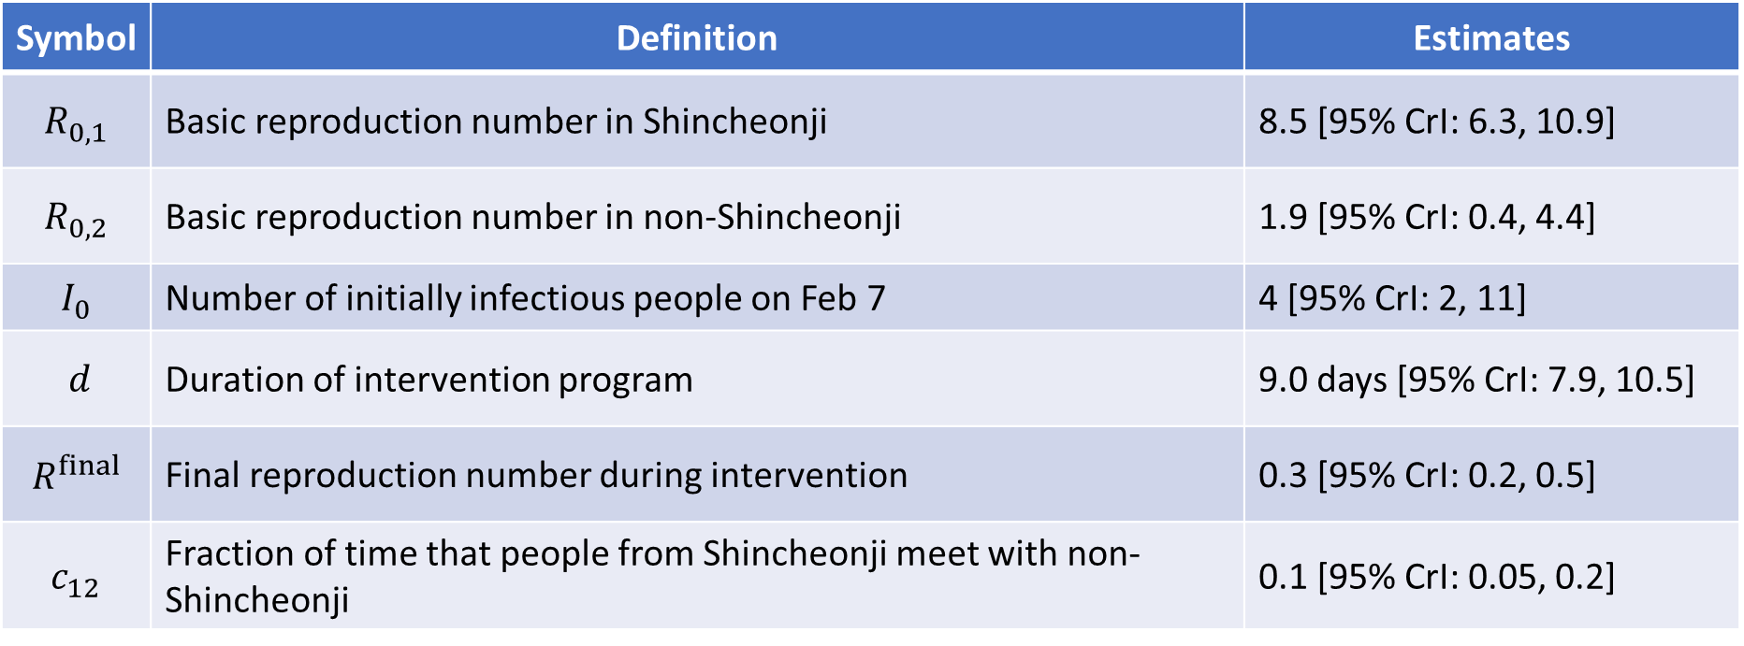
Parameter estimates
Symbol | Definition | Estimates
$$R_{0,1}$$ | Basic reproduction number in Shincheonji | 8.5 [95% CrI: 6.3, 10.9]
$$R_{0,2}$$ | Basic reproduction number in non-Shincheonji | 1.9 [95% CrI: 0.4, 4.4]
$$I_{0}$$ | Number of initially infectious people on Feb 7 | 4 [95% CrI: 2, 11]
$$d$$ | Duration of intervention program | 9.0 days [95% CrI: 7.9, 10.5]
$$R^{final}$$ | Final reproduction number during intervention | 0.3 [95% CrI: 0.2, 0.5]
$$c_{12}$$ | Fraction of time that people from Shincheonji meet with non-Shincheonji | 0.1 [95% CrI: 0.05, 0.2]

Slide 27
Results
R₀ in Shincheonji was around 4-fold higher than the non-Shincheonji 8.5 [95% CrI: 6.3, 10.9] vs. 1.9 [95% CrI: 0.4, 4.4]
High R₀ is not unusual: 5-7 in China and 14.8 in Diamond Princess Ship
Around 4 [95% CrI: 2-11] undetected, infectious people already existed on February 7 when the first cases was symptomatic
There were significant mixing between Shincheonji and non-Shincheonji (C₁₂ = 0.14 [95% CrI: 0.05, 0.22]).
Parameter estimates remain similar upon one-way sensitivity analyses*

Slide 28
Implications
The potential for large variations in R₀ for COVID-19.
Efforts to identify and preempt high transmission scenarios will be key to controlling the spread of the COVID-19

Slide 29
Implications
The potential for large variations in R₀ for COVID-19.
Efforts to identify and preempt high transmission scenarios will be key to controlling the spread of the COVID-19

Slide 30
Questions?

Slide 31
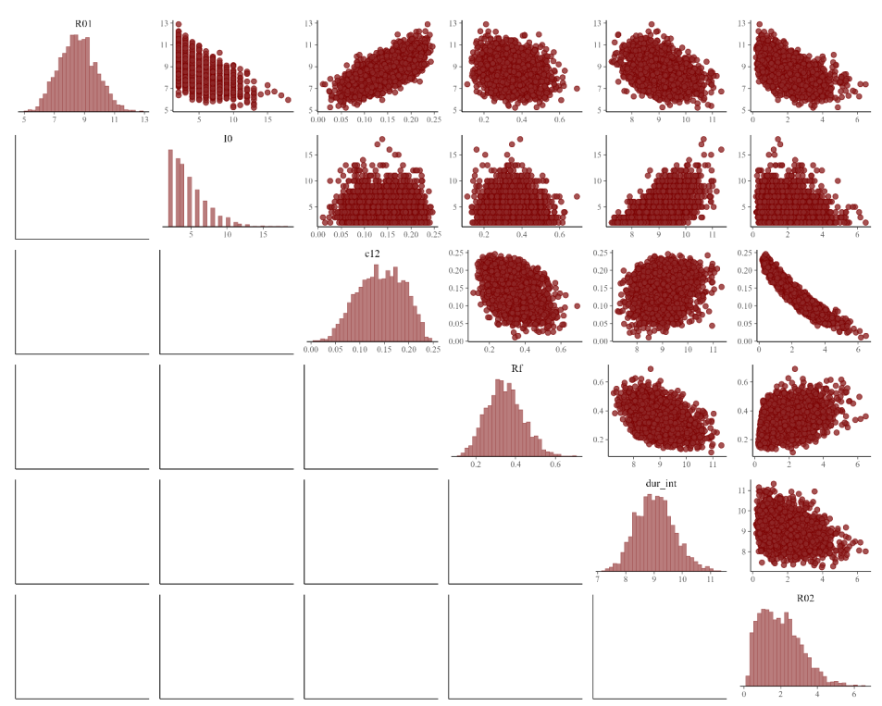
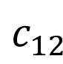
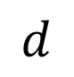
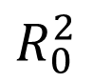
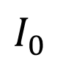
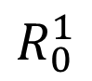
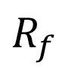
Parameter estimates
$$R_{0}^{1}$$
$$I_{0}$$
$$c_{12}$$
$$R_{f}$$
$$d$$
$$R_{0}^{2}$$
Notes:
Prior distributions for the parameters 𝜃 = {𝑅0,1, 𝑅0,2𝐼0, 𝑐12, 𝑑, 𝑅final} were defined as uniform distribution as follows: 𝑅0,1 ~ 𝑈(1, 20), 𝑅0,2 ~ 𝑈(1, 20), 𝐼0 ~ 𝑈(1, 20), 𝑐12 ~ 𝑈(0.000001, 1), 𝑑 ~ 𝑈(1, 30), 𝑅final ~ 𝑈(1, 20).

Slide 32
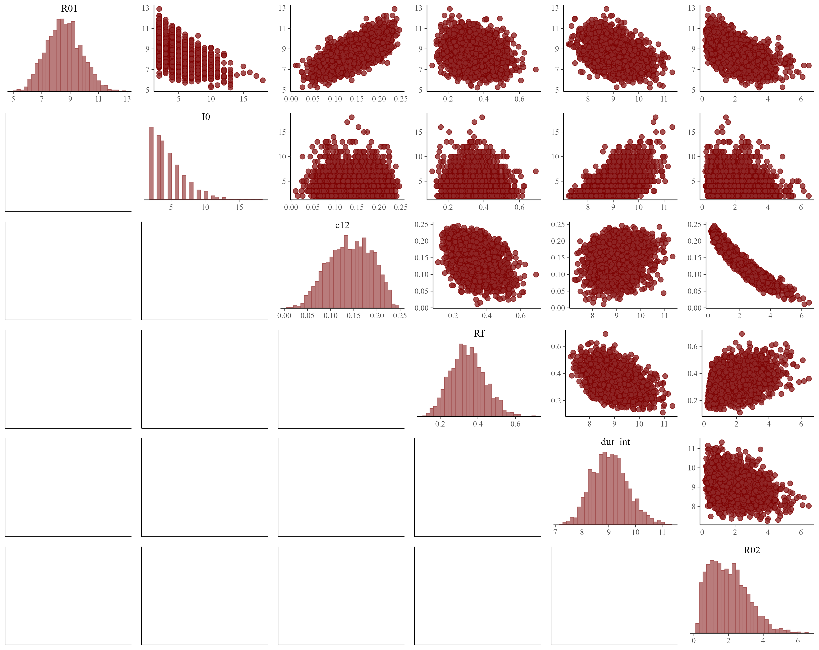
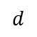
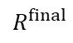
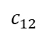
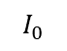
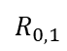
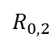
Parameter estimates: Correlations
$$R_{0,1}$$
Positive correlation between R₀ for Shincheonji (R_{0,1}) and mixing between Shincheonji and non-Shincheonji (c₁₂)
Negative correlation between R₀ for non-Shincheonji (R_{0,2}) and c₁₂
$$I_{0}$$
$$c_{12}$$
$$R^{final}$$
$$d$$
$$R_{0,2}$$

Slide 33
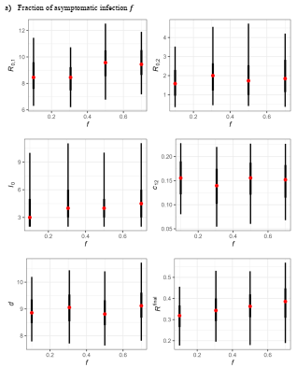
Sensitivity analysis: fraction of asymptomatic people

Slide 34
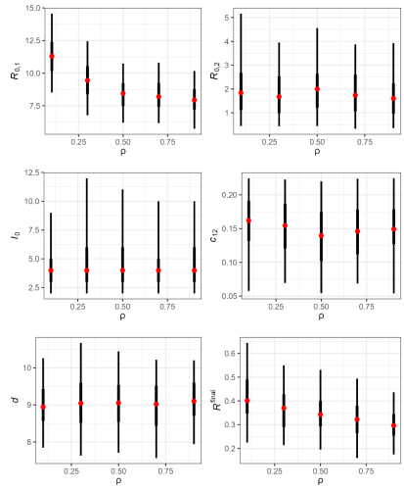
Sensitivity analysis: relative rate of isolation of asymptomatic patients

Slide 35
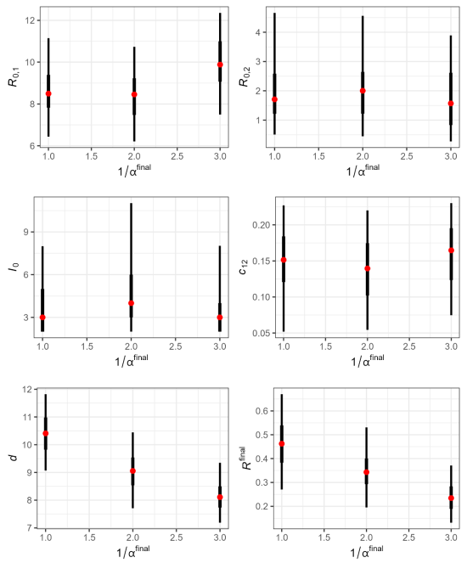
Sensitivity analysis: delay from symptom onset to isolation

Slide 36
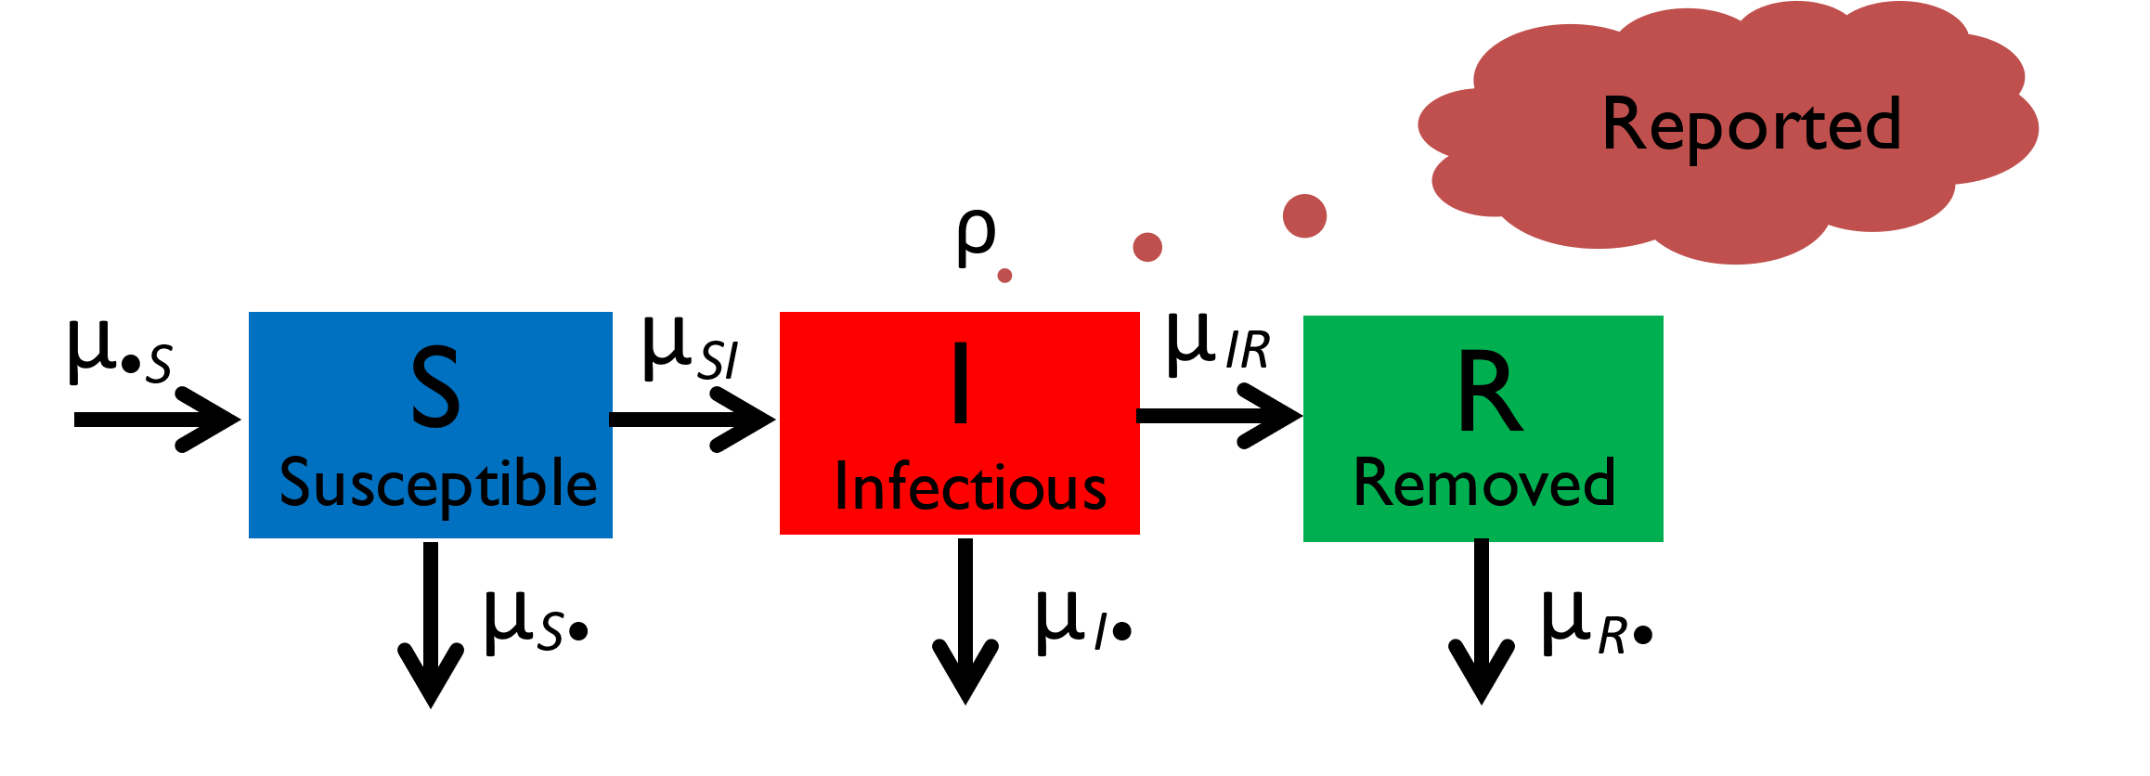
Susceptible-Infected-Recovered (SIR) model
Population is divided into three different classes: S, I, and R
The model describes how the number of people in each class changes with time
μ_{SI} = rate of transition from S to I (i.e., force of infection)
μ_{IR} = rate of recovery
μ_{•S} = birth (or migration)
μ_{S•} = μ_{I•} = μ_{R•} = death (or migration)
Captures a characteristic growth and decay of the number of infectious individuals

Slide 37
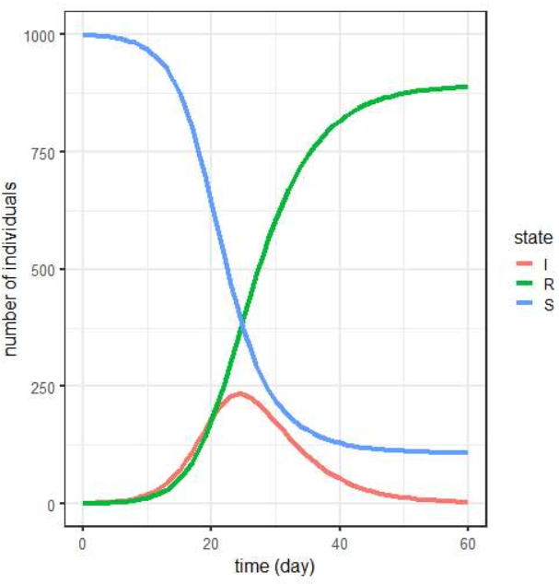
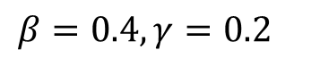
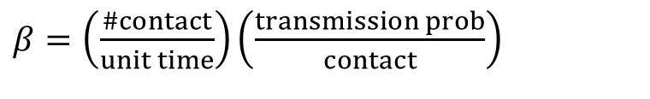
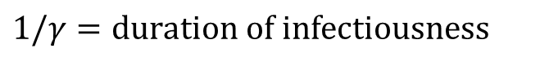
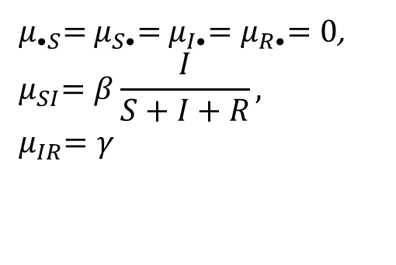
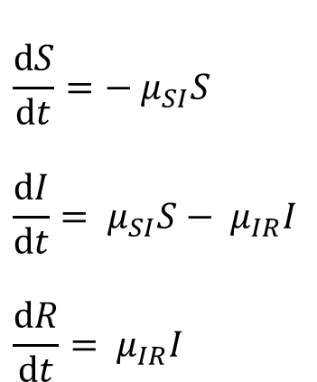
Implementing the SIR model using ordinary differential equations (ODEs)
$$β=0.4, γ=0.2$$
$$\frac{dS}{dt}=−{ μ}_{SI}S$$
$$\frac{dI}{dt}={ μ}_{SI}S−{ μ}_{IR}I$$
$$\frac{dR}{dt}={ μ}_{IR}I$$
${ μ}_{•S}={ μ}_{S•}={ μ}_{I•}{=μ}_{R•}=0$,
$${ μ}_{SI}=β\frac{I}{S+I+R},$$
$${ μ}_{IR}=γ$$
$β=\left(\frac{\#contact}{unit time}\right)\left(\frac{transmission prob}{contact}\right)$
Characteristic growth and decay of an epidemic (red)
The epidemic ends while susceptible people still exist (blue)
$$1/γ=duration of infectiousness$$

Slide 38
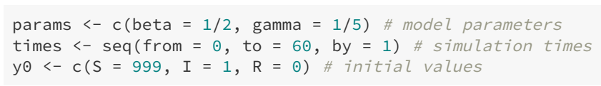
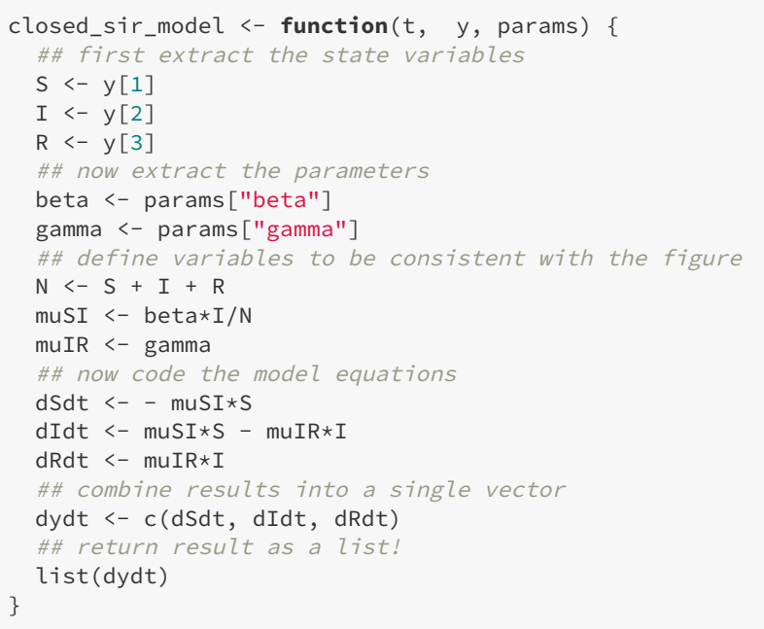
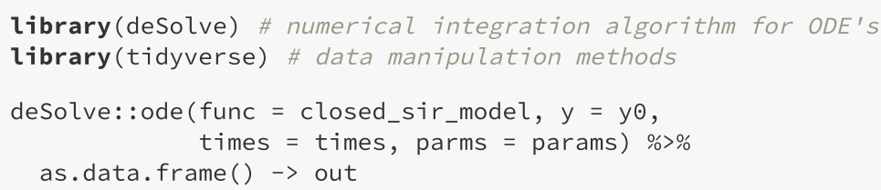

Implementing an SIR model in R

Slide 39
Parameter estimation
Frequentist
Maximum likelihood
Bayesian
Likelihood-based (MCMC, SMC) vs. likelihood-free (ABC, ABC-SMC)
Sampling (MCMC, SMC) vs. approximation (Laplace , MAP)

Slide 40





Parameter estimation: maximum likelihood
Modeling measurement noise using Poisson distribution
Point estimate and 95% confidence interval for θ
data
model-predicted value (i.e., process)

Slide 41


Wuhan data

Slide 42


Findings
β=2.35/4.5 = 0.52

Slide 43



Daily symptom onset across β

Slide 44



Maximize poisson_loglik: Grid search

Slide 45




Implementing the MLE in R
bbmle package

Slide 46


Simulating the model using β_{MLE}
$•$data
95%
ODE model-predicted value (i.e., mean)
typical instance

Slide 47
Approximate Bayesian Computation
Sequential Monte Carlo (ABC – SMC) implementation
1. Toni T. Approximate Bayesian computation scheme for parameter inference and model selection in dynamical systems. Journal of The Royal Society Interface. 2009
2. Minter A, Retkute R. Approximate Bayesian Computation for infectious disease modelling. Epidemics. 2019 Dec 1;29:100368.
https://github.com/amanda-minter/abc_R

Slide 48

ABC – SMC implementation
P(θ|d(D_{0.},D*) ≤ ε) approximates the posterior distribution.
1

Slide 49
ABC – SMC implementation
# ABC SMC algorithm ------------------------------------------------
for (g in 1:G) { # generation
i <- 1 # particle ID
while (i <= npart) {
if (g == 1) { # sample from the prior distributions for the first generation
param <- runif(np, min = lb, max = ub) # initially uniform random
}
else {
p <- sample(seq(1, npart), 1, prob = w_old) # select particles from
param <- rK(mean = res_old[p, ], sigma = sigma)
}
params["beta"] <- param # update beta
Dstar <- daily_case(params)
# distance between the data and the model
dist <- calc_dist(Dstar, wuhan$case)
if (dist <= epsilon_inc[g]) {
distance[g, i] <- dist
res_new[i,1] <- param # store results
w1 <- dunif(res_new[i,1], min = lb, max = ub) # calculate weights
if (g == 1) {
w2 <- 1
} else {
w2 <-
sum(sapply(1:npart, function(x) w_old[x] *
dtruncnorm(res_new[i,1], mean=res_old[x,1], sd=sigma, a=lb, b=ub)))
}
w_new[i] <- w1 / w2
i <- i + 1
}
}
res[g, ] <- res_new
# sigma <- cov(res_new)
sigma <- sd(res_new, na.rm = T)
res_old <- res_new
w_old <- w_new / sum(w_new)
ESS <- round(1/sum(w_old^2))
# ABC SMC algorithm ends -----------------------------------------------
# ABC SMC algorithm initial conditions ------------------------------------------------
tbegin <- Sys.time()
set.seed(42) # to make reproducible
# tolerance levels where initial values are (i.e., maximum difference)
max_diff <- sqrt(sum((2*wuhan$case)^2, na.rm = T))
epsilon_inc <- seq(max_diff, round(0.05 * max_diff), length.out = 20)
G <- length(epsilon_inc)# Generations of SMC
npart <- 200 # Number of particles
n <- 1 # Number of simulations for each parameter set
lb <- c(1e-6) # lower bounds for the parameter values
ub <- c(5) # upper bounds for the parameter values
np <- length(lb) # number of parameters
res <- matrix(nrow=G, ncol = npart) # store history of SMC samples
res_old <- matrix(ncol = np, nrow = npart) # store SMC samples
res_new <- matrix(ncol = np, nrow = npart)
# Empty vectors to store weights
w_old <- matrix(ncol = 1, nrow = npart)
w_new <- matrix(ncol = 1, nrow = npart)
# model parameters. beta will be updated
params <- c(beta = 2.5/4.5, sigma = 1/5.2, gamma = 1/4.5)
distance <- matrix(nrow = G, ncol = npart)
# ABC SMC algorithm initial conditions end here ---------------------------------
# distance function and perturbation kernel
library(truncnorm)
calc_dist <- function(x, y) {
sqrt(sum((x - y)^2))
}
# Perturbation kernel
rK <- function(mean, sigma){
# return(rtmvnorm(1, mean = mean, sigma = sigma, lower = lb, upper = ub))
return(rtruncnorm(1, a = lb, b = ub, mean = mean, sd = sigma))
}
Notes:
# print progress every generation -----------------------------------------
tnow <- Sys.time()
telapsed <- round(difftime(tnow, tbegin, units = "mins")[[1]], digits=1)
# if ESS < npart/2, it indicates an inefficient algorithm
log <- paste0("gen=", g, ", npart=", i-1, ", avg_dist=",
formatC(mean(distance[g,]), digits = 1, format = "f"),
", ess = ", ESS,
", time = ", format(tnow, "%H:%M:%S"),
", min elapsed = ", telapsed)
print(log)
tstamp <- format(tnow, "%Y%m%dT%H%M%S")
write.csv(res_new, paste0("outputs/g", g, "_", tstamp, ".csv"), row.names = F)
}
write.csv(res_new, paste0("outputs/samples_", tstamp, ".csv"), row.names = F)

Slide 50



ABC – SMC results

Slide 51
Case study:
Sequential Monte Carlo (SMC) or particle filtering
1. Speekenbrink M. A tutorial on particle filters. Journal of Mathematical Psychology. 2016 Aug 1;73:140–52.
2. Doucet A, Johansen AM. A tutorial on particle filtering and smoothing: fifteen years later. 2011.

Slide 52
SMC implementation
# SMC algorithm initial conditions ------------------------------------------------
# SMC algorithm initial conditions end here ---------------------------------
# SMC algorithm ------------------------------------------------
# SMC algorithm ends -----------------------------------------------
Notes:
# print progress every generation -----------------------------------------
tnow <- Sys.time()
telapsed <- round(difftime(tnow, tbegin, units = "mins")[[1]], digits=1)
# if ESS < npart/2, it indicates an inefficient algorithm
log <- paste0("gen=", g, ", npart=", i-1, ", avg_dist=",
formatC(mean(distance[g,]), digits = 1, format = "f"),
", ess = ", ESS,
", time = ", format(tnow, "%H:%M:%S"),
", min elapsed = ", telapsed)
print(log)
tstamp <- format(tnow, "%Y%m%dT%H%M%S")
write.csv(res_new, paste0("outputs/g", g, "_", tstamp, ".csv"), row.names = F)
}
write.csv(res_new, paste0("outputs/samples_", tstamp, ".csv"), row.names = F)

Slide 53
Estimating daily reproduction number (R_{t}) of COVID-19 in Korea
Notes:
.

Slide 54

Reproduction number (or ratio), R
R: Average number of secondary cases by a single infected people
R₀: when the entire population is susceptible
R_{t} (R_{eff}): when some of the people are not susceptible
R gives information on
Likelihood of a major outbreak
Speed of a disease spread
Final size of an outbreak
Minimum immunization coverage to prevent an outbreak (herd immunity)
Impact of intervention programs
$$R=\frac{Number of secondary cases }{Number of primary cases}$$

Slide 55



Estimating R_{t} given daily number of confirmed cases
$$R=\frac{Number of secondary cases }{Number of primary cases}$$
$$R_{t}=\frac{Number of new infections after time t}{Number of those who are infected at time t}$$
$$vs. R_{t}=\frac{Number of those who are infected at time t}{Number of those who are already infectious at time t}$$

Slide 56
A way to calculate instantaneous reproduction number, R_{t .}
$$R_{t}=\frac{Number of those who are infected at time t}{Number of those who are already infectious at time t}=\frac{I_{t}}{\sum_{s=1}^{t}{I_{t−s}w_{s}}}$$
Cori et al (2013) Am J Epidemiol
Generation time distribution
Fraser (2007) PLoS One
Prob. of 2° transmission
1 | 2 | 3 | 4 | 5 | 6 | 7 | 8
-8 | -7 | -6 | -5 | -4 | -3 | -2 | -1
t
Days since infection

Slide 57
Limitations of the method and an alternative
Cori et al. method
Infection time series not available
R_{t} estimates are delayed by the interval between infection and confirmation if confirmation time series are used (incubation period + symptom onset to confirmation)
Serial interval may not be a good substitute for the generation interval
SEPIAR model
The SEPIAR model fitted to the confirmation time series naturally gives inferred infection time series
The SEPIAR model may be used to simulate intervention scenarios (e.g., implementation of intervention programs)

Slide 58


Estimating R_{t} using a SEPAIR model: background
Asymptomatic
Compare model-predicted daily change of recovered with daily-confirmed case
μ
A
S
SE
E
P
R
Susceptible
Exposed
I
Removed
Pre-symptomatic
Infectious
$E\left(t+Δt\right)={E\left(t\right)+Binom(S(\text{t}\text{)}, 1−exp(−μ}_{i}^{SE}$))
$${ μ}_{SE}(t)=β(t)\frac{I+{ b}_{P}P+{ b}_{A}A}{S+E+P+I+A+R}$$
Estimate β(t), transmission rate at time t, given the number of cases at time t using particle filtering (forward filtering with backward sampling)

Slide 59

Estimating R_{t} using particle filtering
Maarten Speekenbrink (2016) J Math Psychol

Slide 60
Goals
Mechanistic model of disease transmission
Bayesian sampling methods for estimating parameters
Notes:
.

Slide 61



Estimating R_{t} using a SEPAIR model
Blue: confirmation
Red: infection
Grey: confirmation (data)
Estimating R_{t} using a simulated dataset
darker shade: 50%
lighter shade: 95%
line: median
- - -: true R(t)

Slide 62
Conclusion II
The SEPIAR model with particle filtering can successfully estimate true R_{t} when applied to a simulated data set
The SEPIAR model with particle filtering may be a better alternative to estimate daily R_{t} in real time compared to the existing method by Cori et al.

Slide 63
Software
R has diverse packages developed by experts
R is slow so you need to be ready to tackle some C/C++ codes
pomp (https://cran.r-project.org/web/packages/pomp/pomp.pdf)
Julia (https://julialang.org/) with Turing (https://turing.ml/stable/) package appears to be a better alternative for fitting dynamic infectious disease models
Bayesian Statistics using Julia and Turing (https://storopoli.io/Bayesian-Julia/)

Slide 64
Case study: MCMC Jupyter notebook

Slide 65
Any questions?

Slide 66



Doubling time, T_{d}
Kim et al. Epidemics 37 (2021) 100519

Slide 67
Modeling process
Ask questions
Collect data
Model
(Process & measurement)
Estimate parameters
(Point & interval)
Answer questions
Adapted from Bolker (2007) Ecological Models and Data in R (p.27)

Slide 68

Model fitting or parameter estimation: ABC SMC
ABC rejection

Slide 69

Sequential Monte Carlo

Slide 70


Model fitting or parameter estimation: ABC SMC

Slide 71


Statistical vs. mechanistic models
Statistical models
Fitting a line or curve to data and extrapolating
Usually don’t account for how transmission occurs--not well suited for long-term predictions about epidemiologic dynamics or for inference about intervention efficacy.
Serial Interval of COVID-19
Nishiura et al. IJID 93 (2020) 284–286
Du et al. (2020) Emerg Infect Dis

Slide 72


Statistical vs. mechanistic models
Mechanistic models
Epidemiologic, transmission, dynamic, mathematical, or compartmental models
Susceptible–Exposed–Infectious–Recovered (SEIR)
Forecast or simulate transmission scenarios (with or without intervention programs)
Include mechanisms to mimic the way SARS-CoV-2 spreads
Hao et al. (2020) Nature

